Slide 1
A Machine Learning Model to Predict The Individuals at High Risk in COVID-19 Infection
Brydon, Riley, Morteza, Hossein

Slide 2
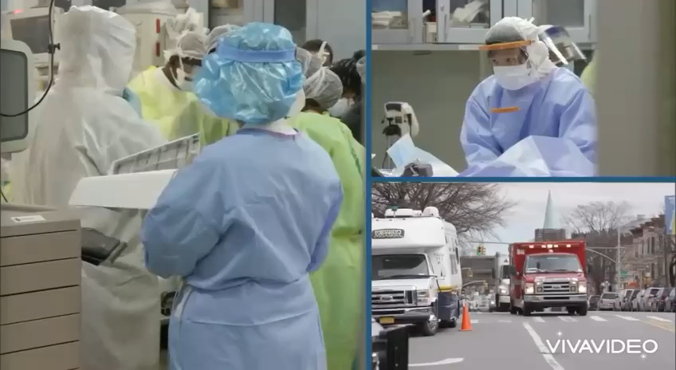
Background

Slide 3

Now We Have a History, What’s Next? The Prediction of More Vulnerable People in the COVID-19 Pandemic via machine learning
Targeted Interventions: The healthcare providers can prioritize and tailor medical interventions.
Optimized Resource Allocation: Predictive modeling helps efficiently allocate limited healthcare resources such as ICU beds, ventilators, and medical personnel.
Reduced Hospital Burden: By preventing severe cases through early intervention, hospitals can avoid becoming overwhelmed.
Long-Term Health System Improvements: Over time, the integration of machine learning into health systems can lead to ongoing improvements in how diseases are managed, with more personalized, predictive healthcare becoming the norm.

Slide 4
Our Models

Slide 5
Limitations
Evolving Virus Dynamics: Rapid changes in the virus's behavior can render models based on historical data less accurate over time.
Computational Demands: Sophisticated models require extensive computational resources that may be inaccessible in resource-constrained environments.
Feature Inclusivity: If critical predictive characteristics are missing or incorrectly recorded in the dataset, the model's efficacy suffers.

Slide 6
Future Directions
Continuous Learning Systems: Implement continuous learning where models are routinely updated with new data, reflecting the latest trends and discoveries.
Integration Frameworks: Develop frameworks for seamless integration of machine learning models with existing healthcare IT systems, promoting widespread adoption.
Interpretable AI: Invest in explainable AI research to improve the transparency of model predictions, aiding clinicians in understanding and trusting AI-driven decisions.

